Slide 1

noPhish
Yash Saboo
09-July-18

Slide 2
Agenda
1
Introduction
2
noPhish
3
Stage 1 – 5 Description
4
Software and Hardware Tools and Process Model
5
Software Engineering
6
Related Work
7
Conclusion
8
Future Work

Slide 3
Introduction - Phishing
Why does phishing work? Basically because con artists are really good at persuading people to do really dumb things.
– Richard Clayton, Cambridge Computer Laboratory
Attempt to obtain sensitive information by disguising as a trustworthy entity
Ways to prevent phishing:
Blacklists
Browser Plugins and Extensions
Nohack
Phishing Boat
Netcraft
Stop Phishing
Password Alert
Notes:
Spear Phishing
Targeted attack
Hacker knows which specific individual or organization they are after
More personalized
Increase the likelihood of the target falling into their trap.
Email/Spam
Most common phishing technique
The same email is sent to millions of users
Email contains:
Fill in personal details.
Urgent note which requires the user to enter credentials to update account information, change details, or verify accounts.
Fill out a form to access a new service through a link which is provided in the email.
Web Based Delivery
Most sophisticated phishing techniques.
Also known as “man-in-the-middle,”
The hacker is located in between the original website and the phishing system.
The phisher traces details during a transaction between the legitimate website and the user.
As the user continues to pass information, it is gathered by the phishers, without the user knowing about it.
Link Manipulation
Phisher sends a link to a malicious website.
The deceptive link, it opens the phisher’s website instead of the website mentioned in the link.
Hovering the mouse over the link to view the actual address stops users from falling for link manipulation.
Keyloggers
Keyloggers refer to the malware used to identify inputs from the keyboard.
The information is sent to the hackers who will decipher passwords and other types of information.
To prevent key loggers from accessing personal information, secure websites provide options to use mouse clicks to make entries through the virtual keyboard.
Trojan
Type of malware designed to mislead the user with an action that looks legitimate, but allows unauthorized access to the user account to collect credentials through the local machine.
Malvertising
Malicious advertising that contains active scripts designed to download malware or force unwanted content onto your computer.
Exploits in Adobe PDF and Flash are the most common methods used in malvertisements.
Session Hijacking
The phisher exploits the web session control mechanism to steal information from the user.
In a simple session hacking procedure known as session sniffing, the phisher can use a sniffer to intercept relevant information so that he or she can access the web server illegally.
Content Injection
Content injection is the technique where the phisher changes a part of the content on the page of a reliable website.
This is done to mislead the user to go to a page outside the legitimate website where the user is then asked to enter personal information.
Phishing through Search Engines
Some phishing scams involve search engines where the user is directed to products sites which may offer low cost products or services. When the user tries to buy the product by entering the credit card details, it’s collected by the phishing site. There are many fake bank websites offering credit cards or loans to users at a low rate but they are actually phishing sites.
Vishing (Voice Phishing)
In phone phishing, the phisher makes phone calls to the user and asks the user to dial a number. The purpose is to get personal information of the bank account through the phone. Phone phishing is mostly done with a fake caller ID.
Smishing (SMS Phishing)
Phishing conducted via Short Message Service (SMS), a telephone-based text messaging service. A smishing text, for example, attempts to entice a victim into revealing personal information via a link that leads to a phishing website.
Malware
Phishing scams involving malware require it to be run on the user’s computer. The malware is usually attached to the email sent to the user by the phishers. Once you click on the link, the malware will start functioning. Sometimes, the malware may also be attached to downloadable files.
Ransomware
Ransomware denies access to a device or files until a ransom has been paid.
Ransomware for PC's is malware that gets installed on a user’s workstation using a social engineering attack where the user gets tricked in clicking on a link, opening an attachment, or clicking on malvertising.

Slide 4
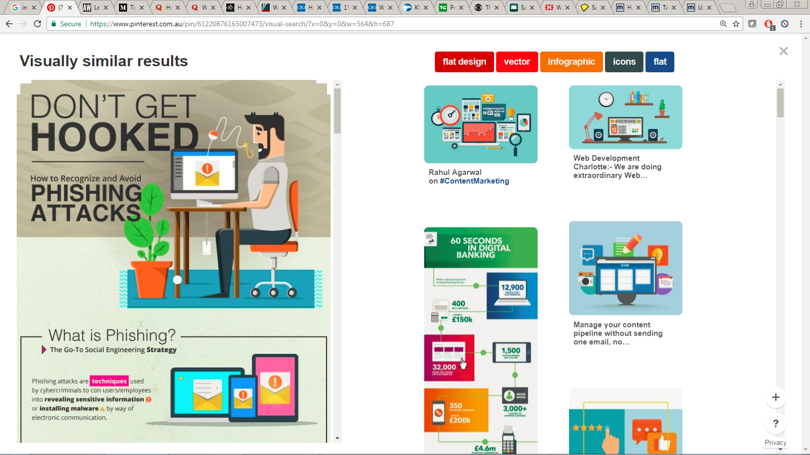
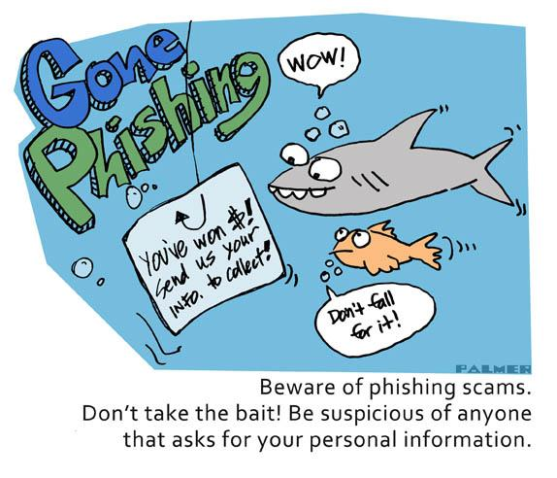
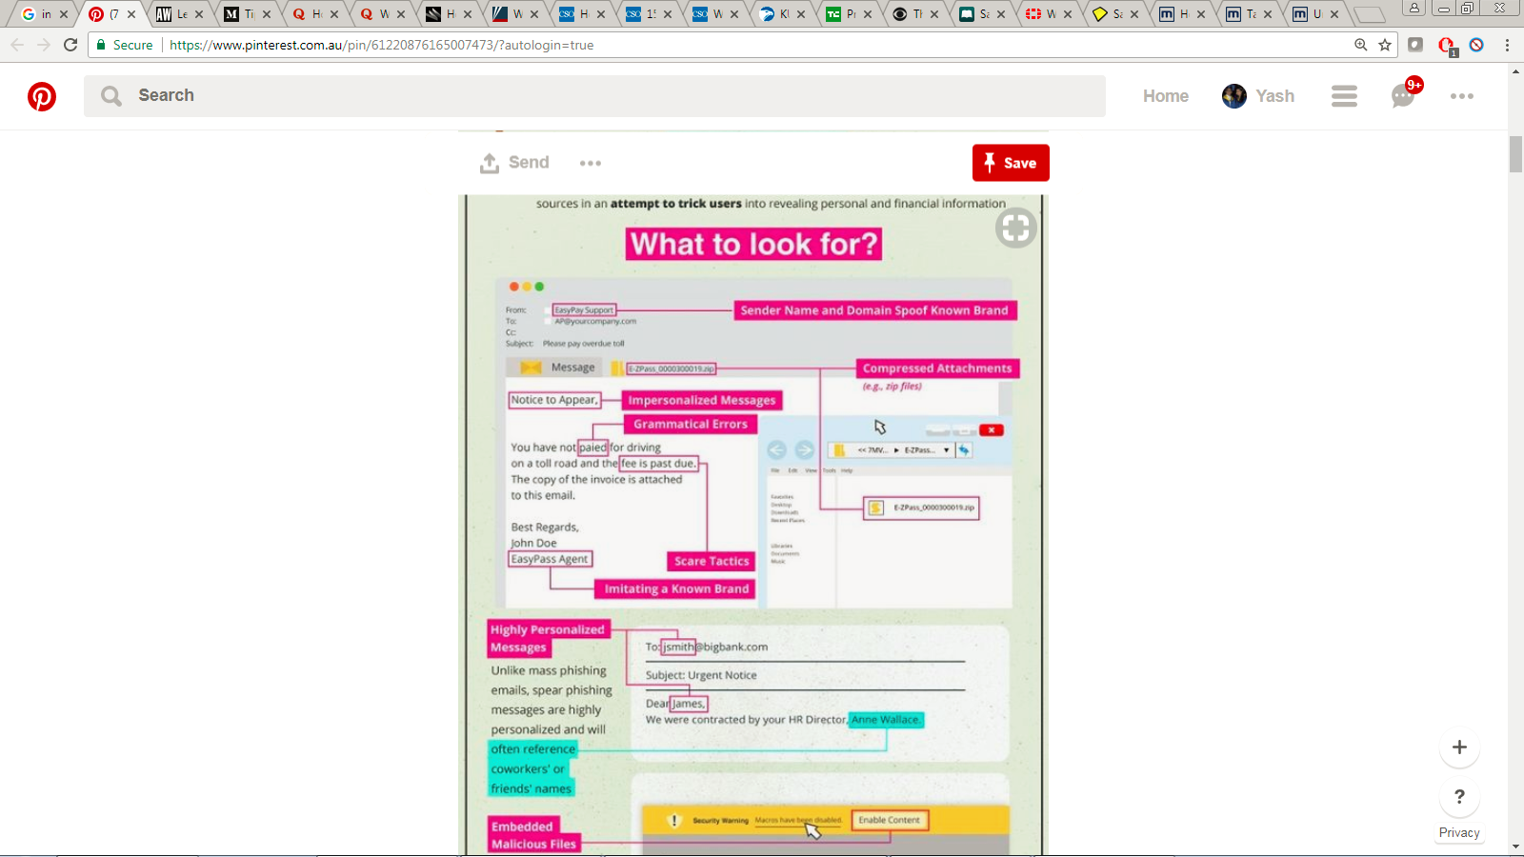
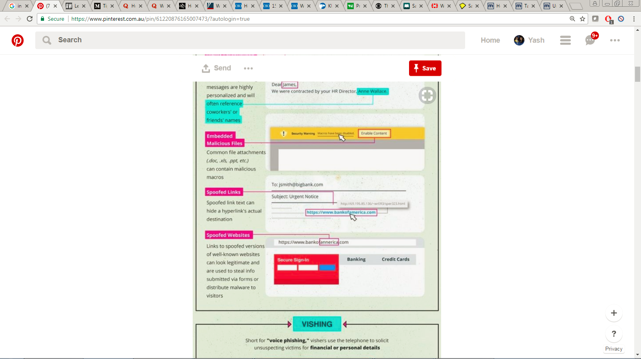

Slide 5
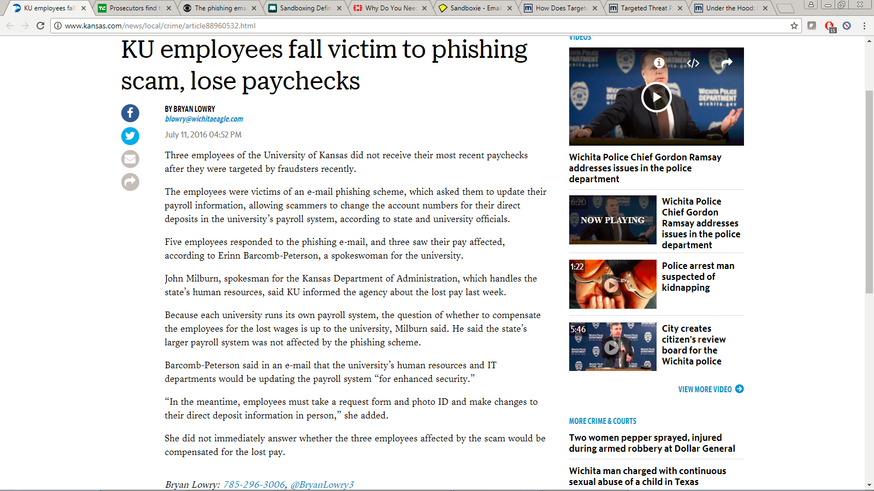

Slide 6
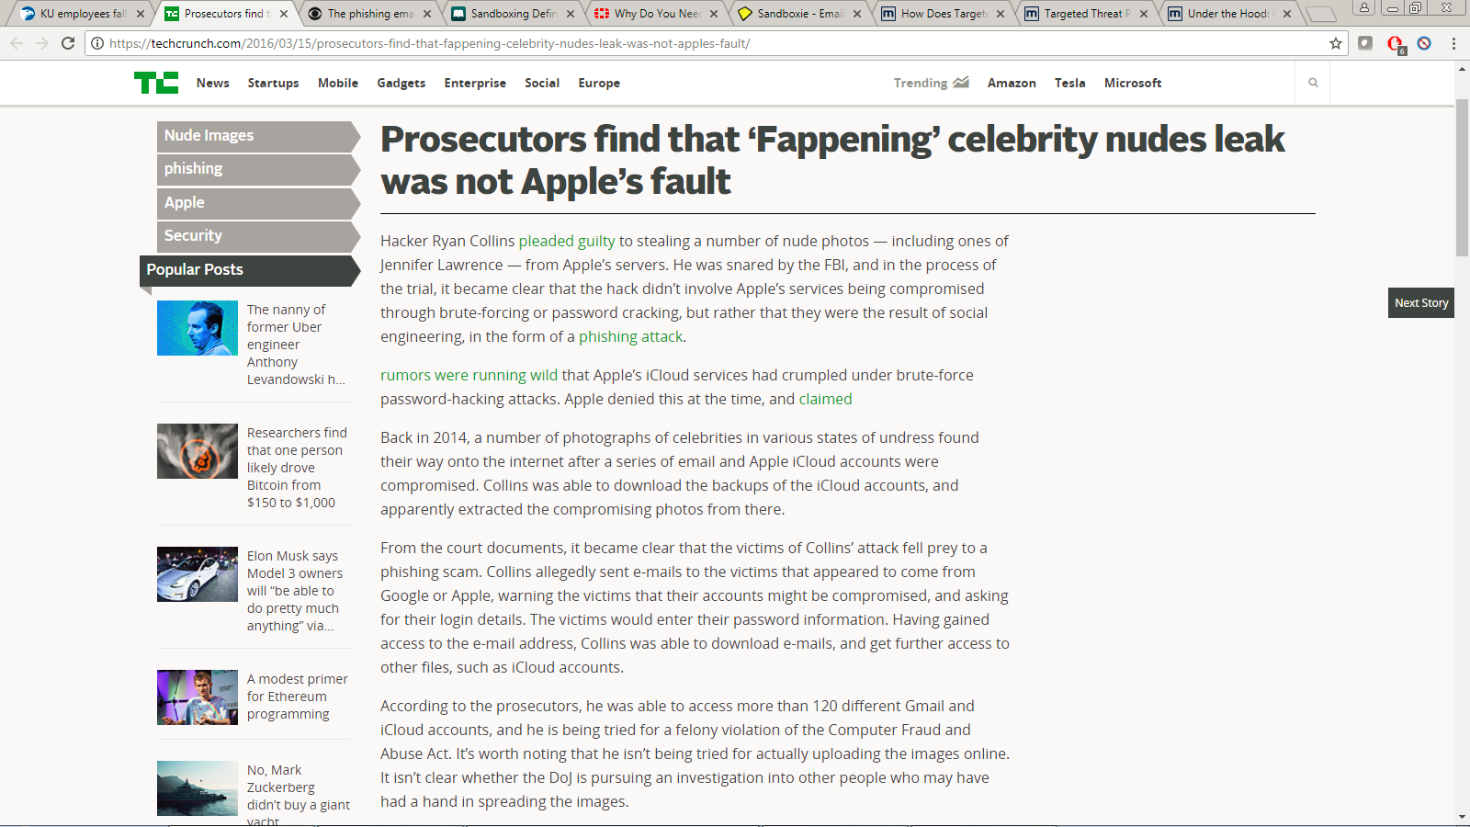

Slide 7
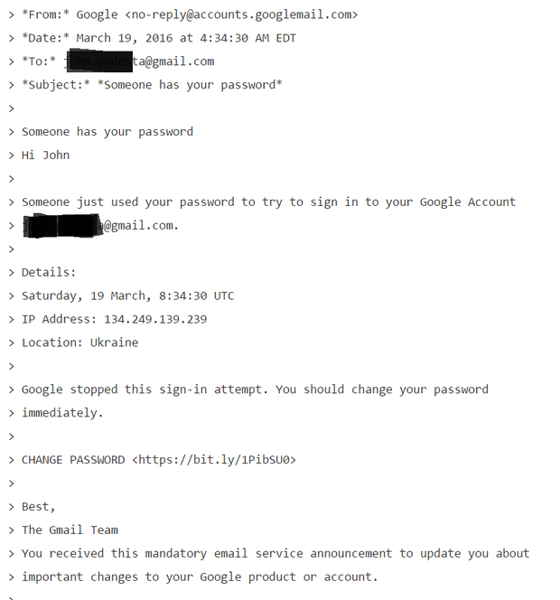
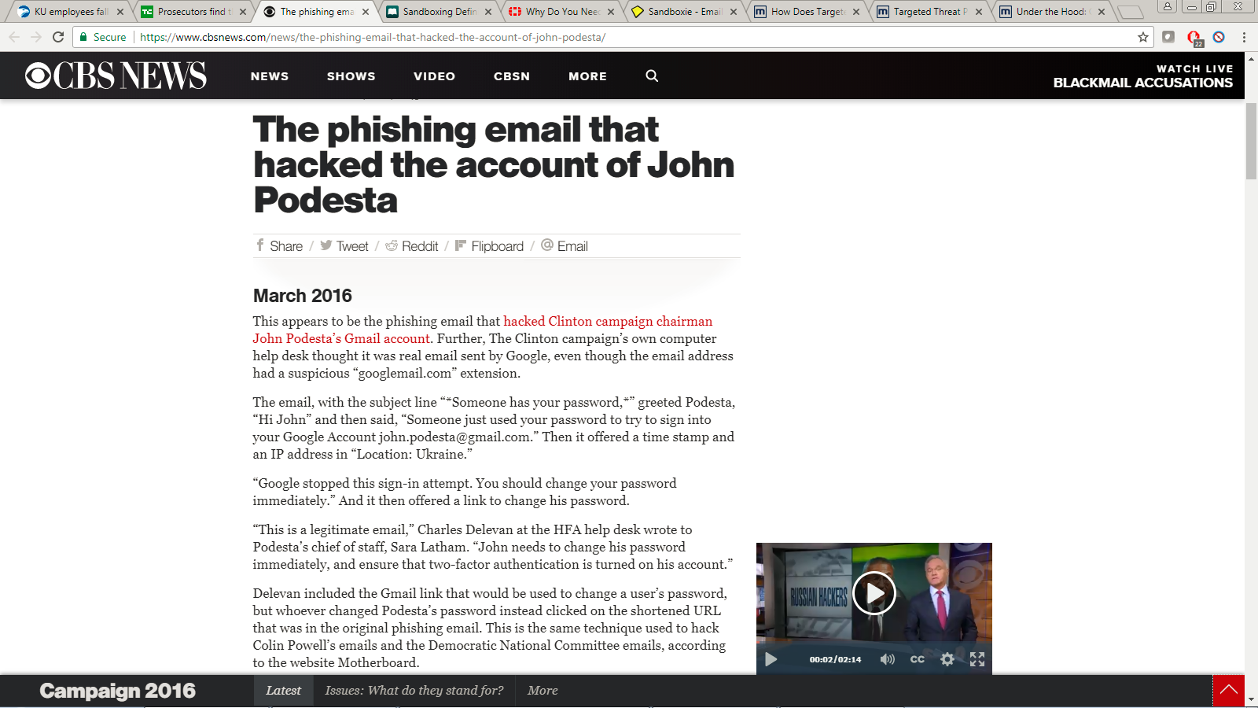
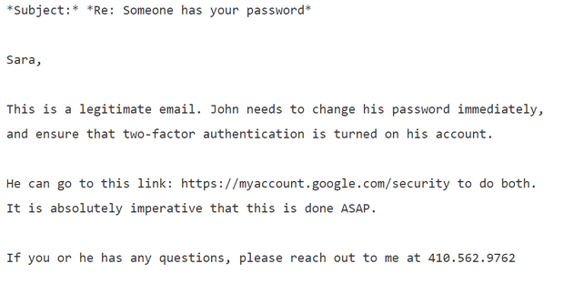

Slide 8
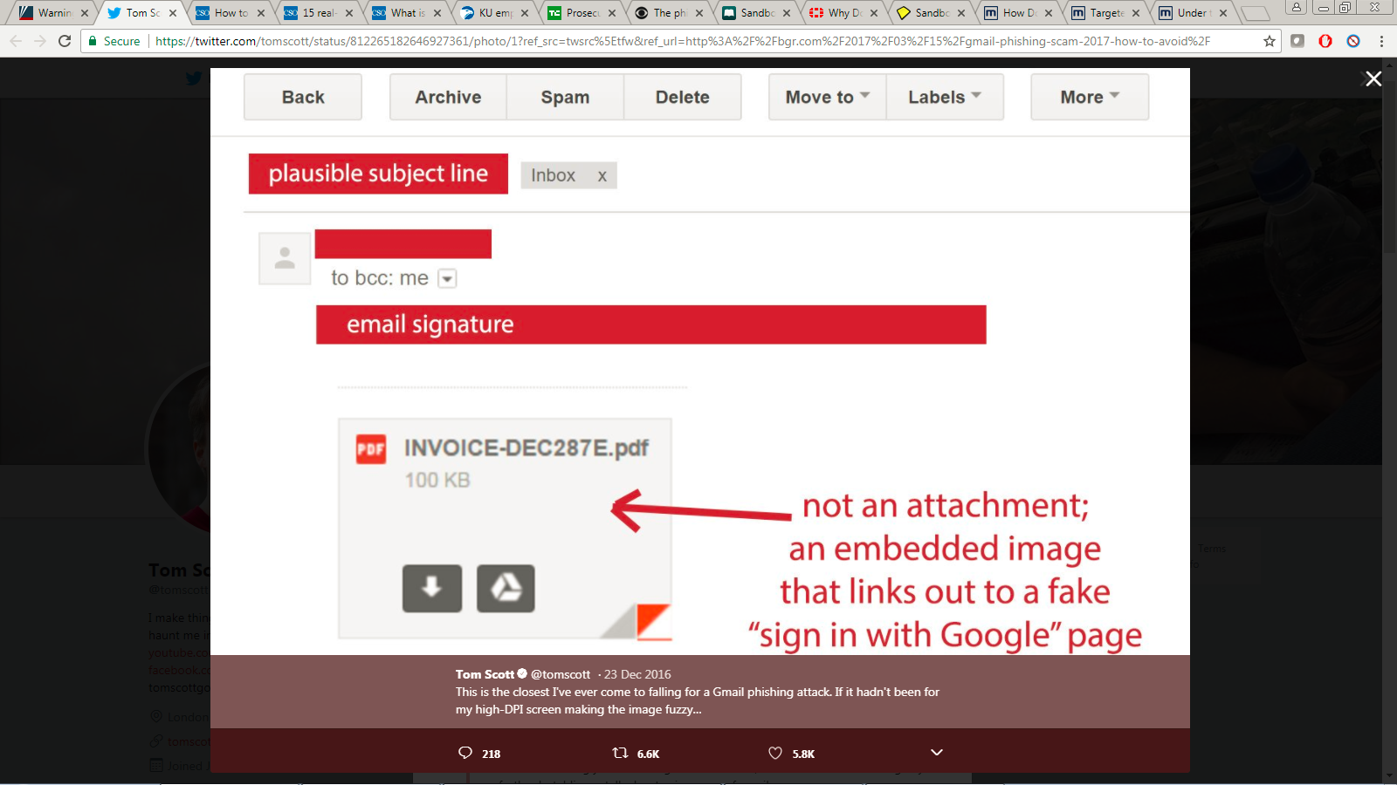

Slide 9
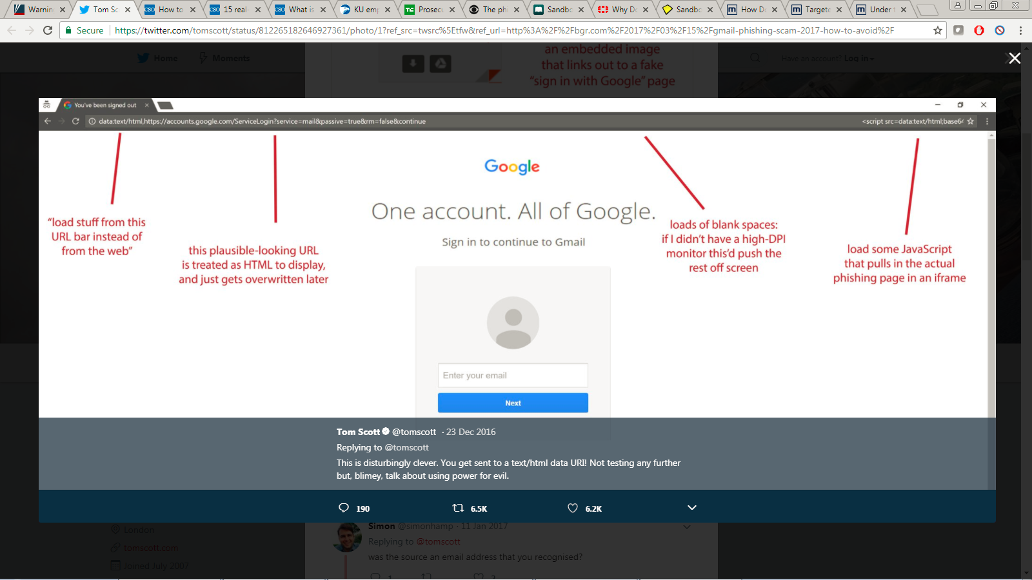

Slide 10
noPhish
Google Chrome extension
Classifies websites into Phishing and Legitimate using following techniques:
Machine Learning
Image Processing
Data Mining
Classification happens in real-time.

Slide 11
Development of noPhish
Took place in 5 stages
Stage 1: Prototype of Chrome Extension.
Stage 2: Code Comparator.
Stage 3: Automated Feature Extraction.
Stage 4: XGBOOST binary classifier based on technical aspects of the website.
Stage 5: DBSCAN Clustering model based on the visual aspect of the website.

Slide 12
Stage 1
Chrome Extension
Extensions customize the browsing experience.
Can be built only on web technologies such as HTML, JavaScript, and CSS
Implemented Client-Server architecture, where the client is any user using noPhish.

Slide 13
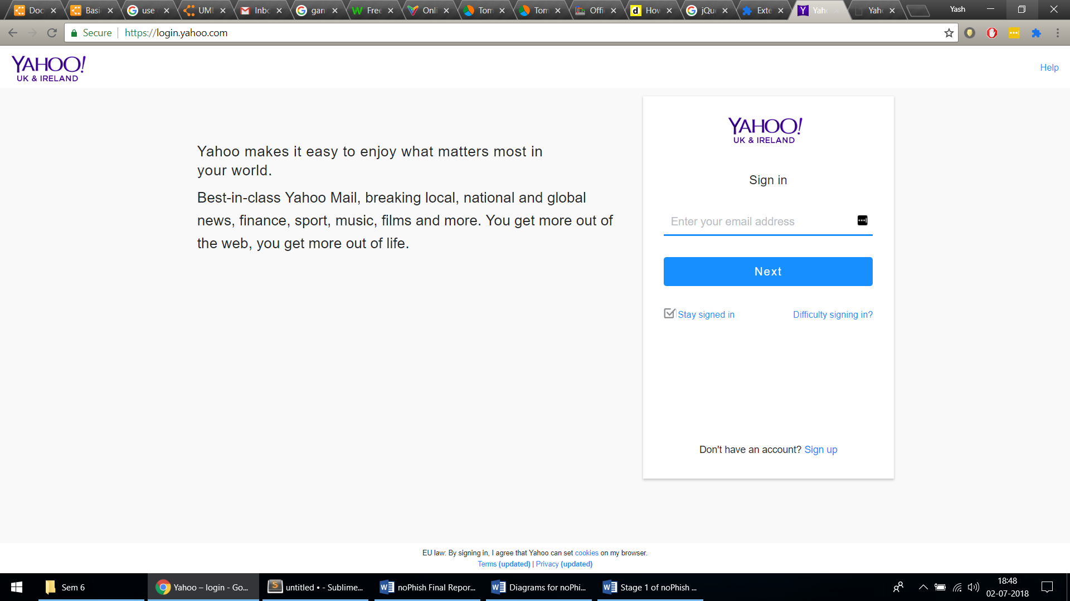
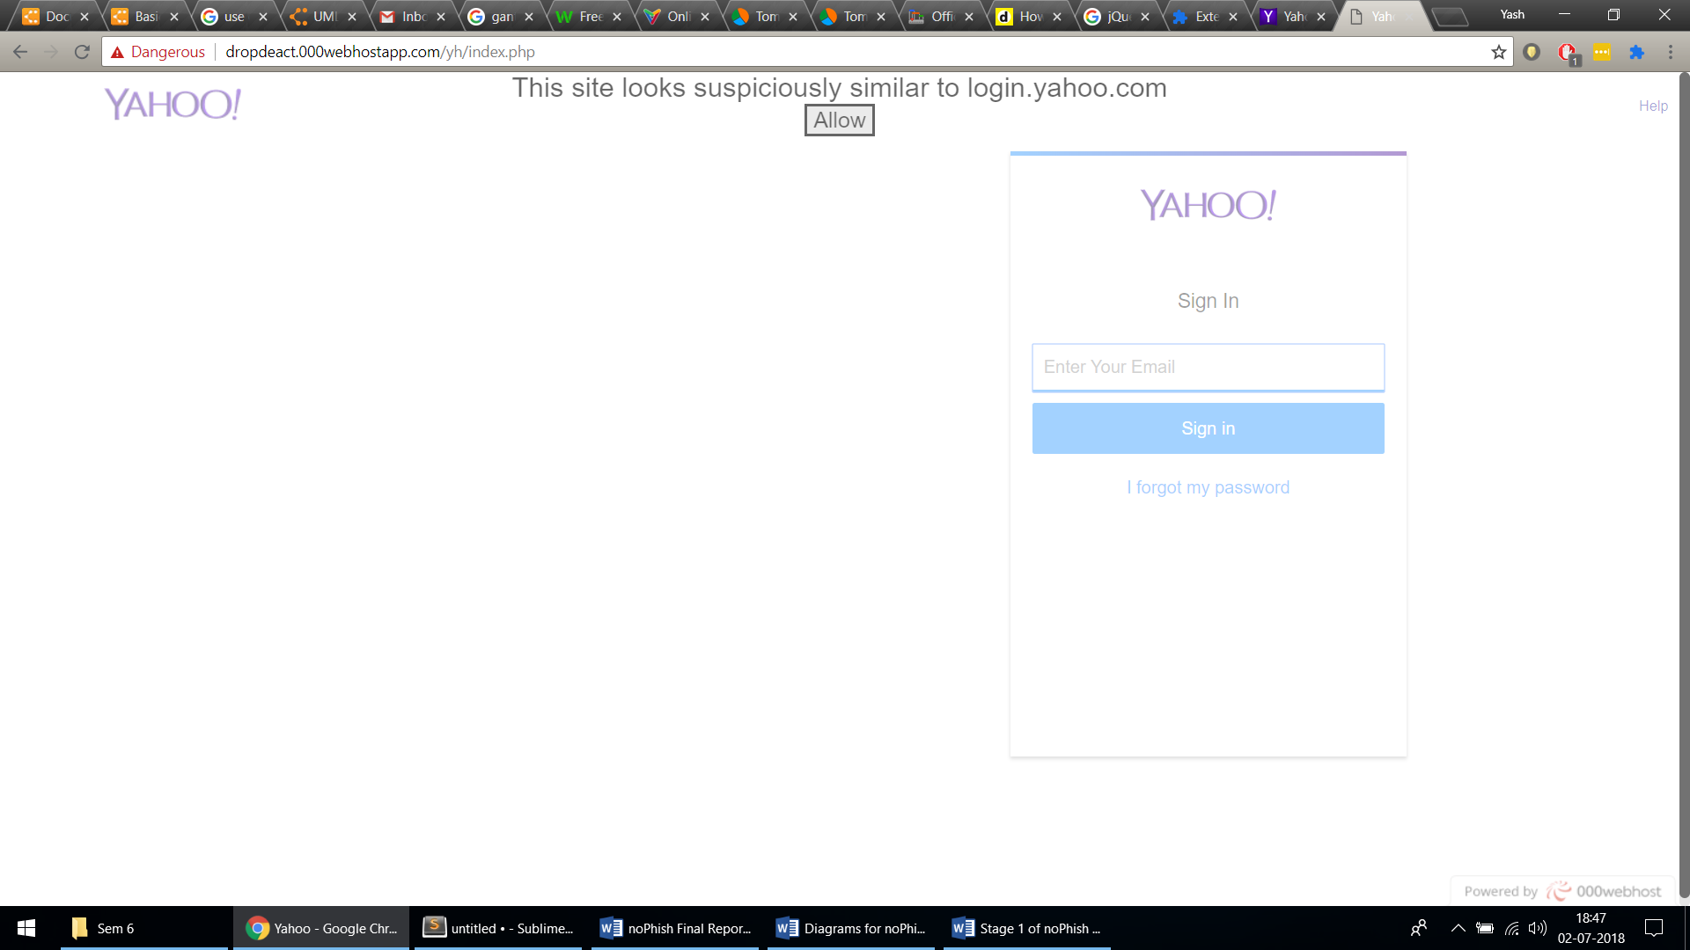
Legitimate page of Yahoo Login. No warning is issued by the extension (blue color extension in address bar) so it correctly identified it as Legitimate website.
Phishing page of Yahoo Login. A warning is issued by the extension (blue colour extension in address bar) so it correctly identified it as Phishing website.

Slide 14
Stage 2
Code Comparator
Data Selection
Phishing URLs: Phishtank
Legitimate URLs: Alexa
Development:
Extract page source (underlying code) of the website.
Using ‘difflib’ library, find the similarity between two websites.
Testing:
No correlation was found between a legitimate website’s code and it’s phishing website’ code.
Thus, the idea was scraped out.

Slide 15
Text Scraping
Why it didn’t work out?
Same website can be written in many different combination of scripting languages.
Rearrangement of the modules doesn’t change the website functionalities.
Naming problem, that is the same Image can be saved with a different name.
Some HTML contents are written on single line with no new line feed. Though this was solved by splitting the text in different lines but it didn’t help significantly.
Some HTML contents are in hexadecimal format which makes it incomparable to original one.
The script changes when website are written for specific country. For example, if Facebook is specially designed for France then the text written will all be in French. Thus, difference in code increases and similarity decreases.

Slide 16
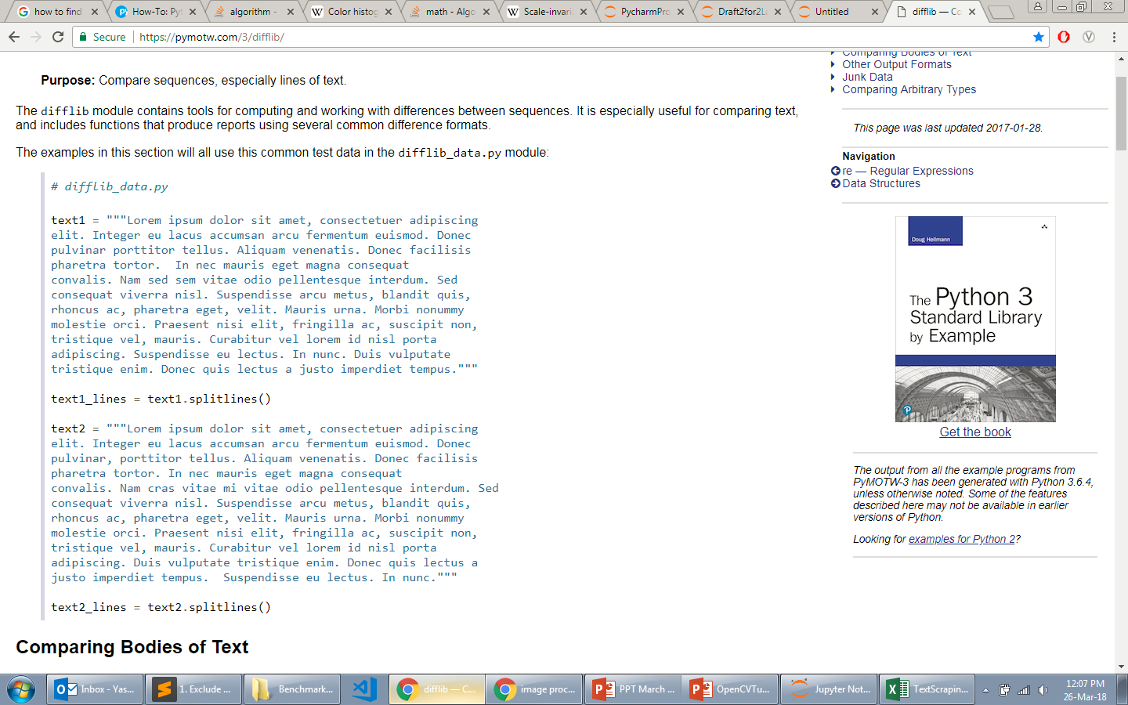
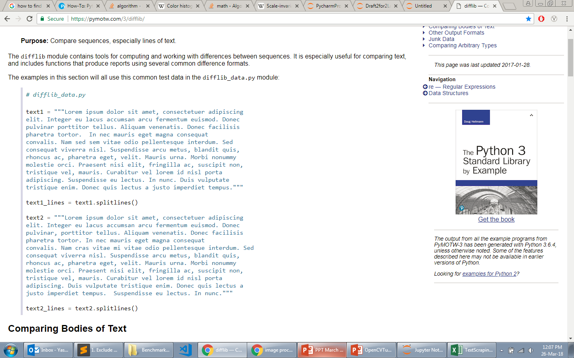
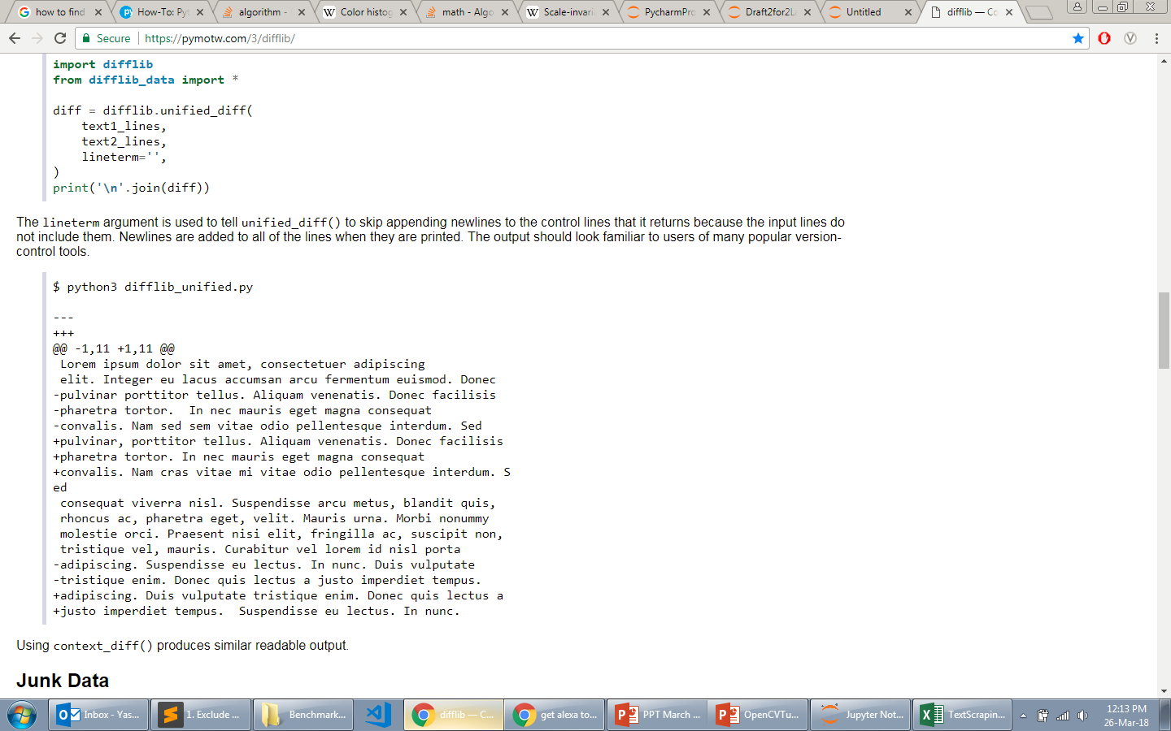
Lines prefixed with - were in the first sequence, but not the second.
Lines prefixed with + were in the second sequence, but not the first.
Notes:
3rd line – comma
4th line – Extra Whitespace
5th line – cras instead of sed sem

Slide 17
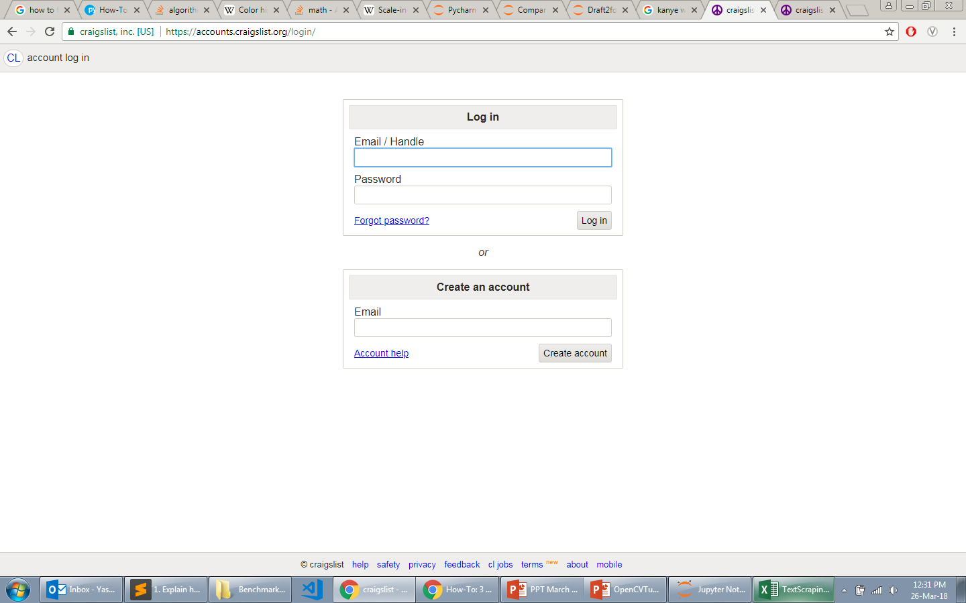
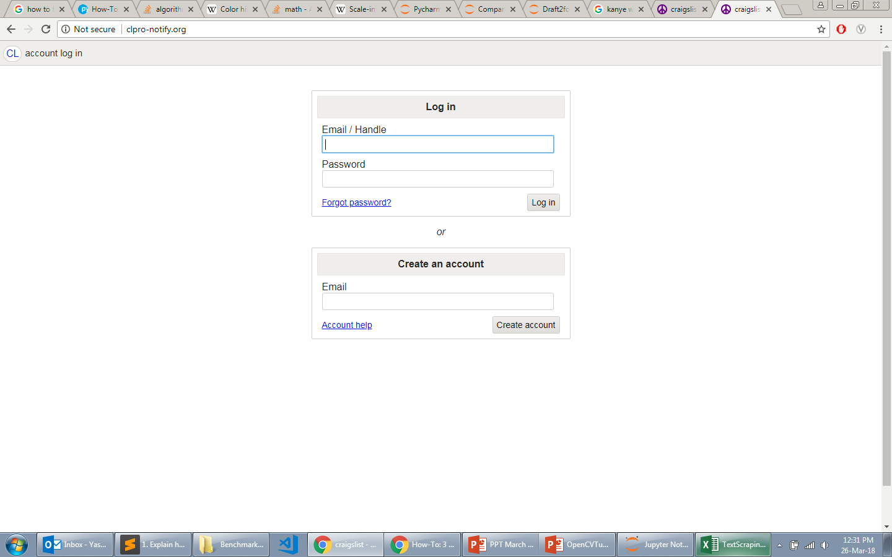
This is the case where the text matched 20.21%, but it was that considerable. This case could have been easily identified by image hashing algorithm.

Slide 18
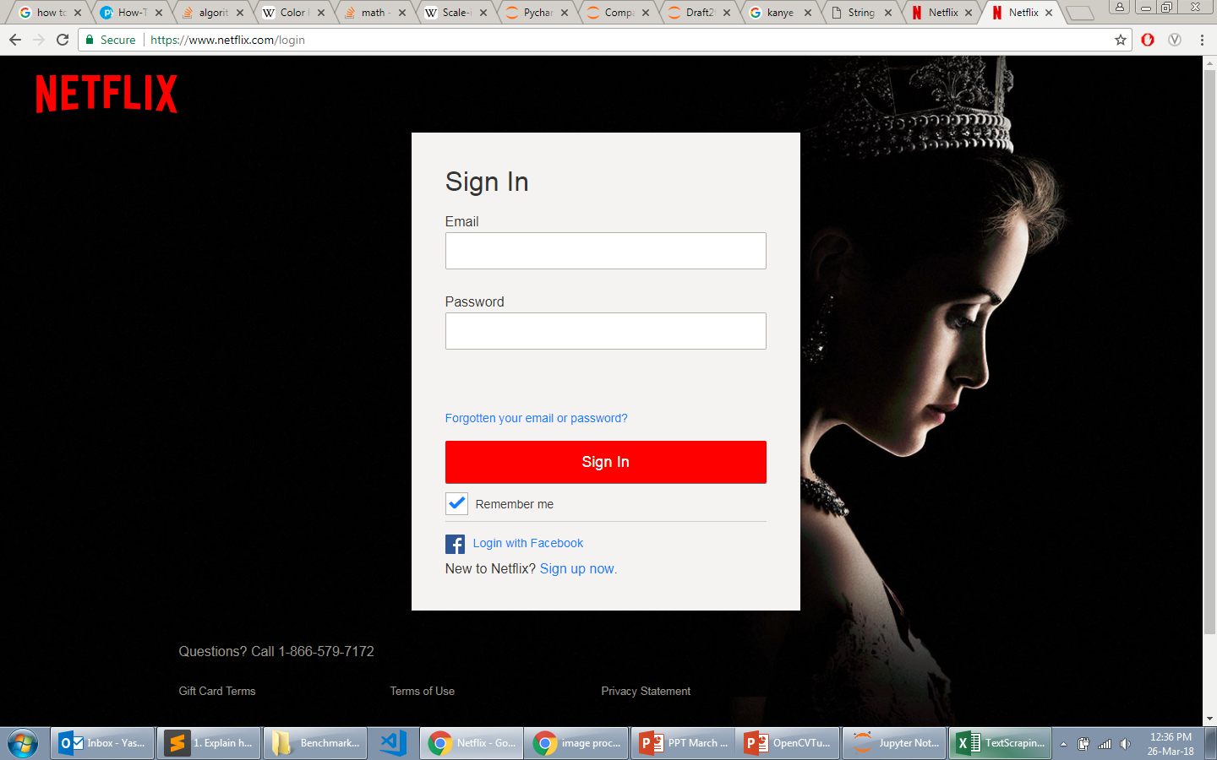
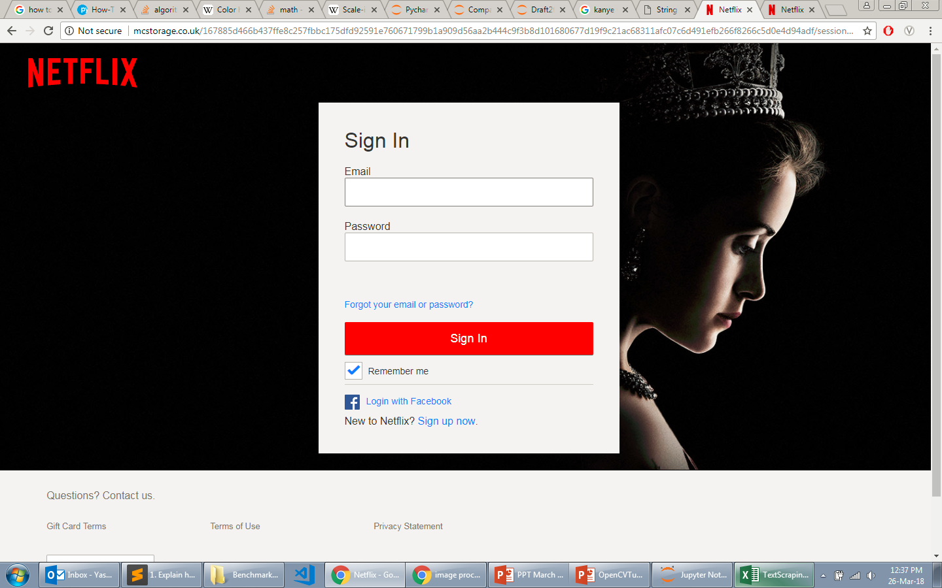
As the image looks similar with just the bottom bar’s color changed to white, the HTML content supposedly should be same. But, it wasn’t that case. There was only 7.11% similarity.

Slide 19
Stage 3
Automated Feature Extraction
Data Selection
Phishing URLs: Phishtank
Legitimate URLs: Alexa
Pre-processing Data
Formatting
Cleaning
Binarize Data
Text Mining
TFIDF
One Hot Encoding
Implementation
Input: List of URLs with each having a label of “Phishing” or “Legitimate”
Output: CSV file which will have various features – both for Level 1 and 2 – for each input URL.

Slide 20
Technical Features
Automated Feature Extraction
The following are the umbrella of the technical features used along with few exact feature definition:
URL Features (Domain tokens, path tokens, query parameters, number of subdomains, length of domain, length of path, length of URL )
HTML Headers (Tokens of all field names and values)
SSL/TLS Certificate (Unique name certificate, Geographic location fields)
WHOIS Features
Website’s HTML and JavaScript Features (URL features for each link, number of links, Tokens of main HTML, frame HTML, Spelling match, Copying Website, Disabling Right Click, Submission of info using submit button and script content)

Slide 21



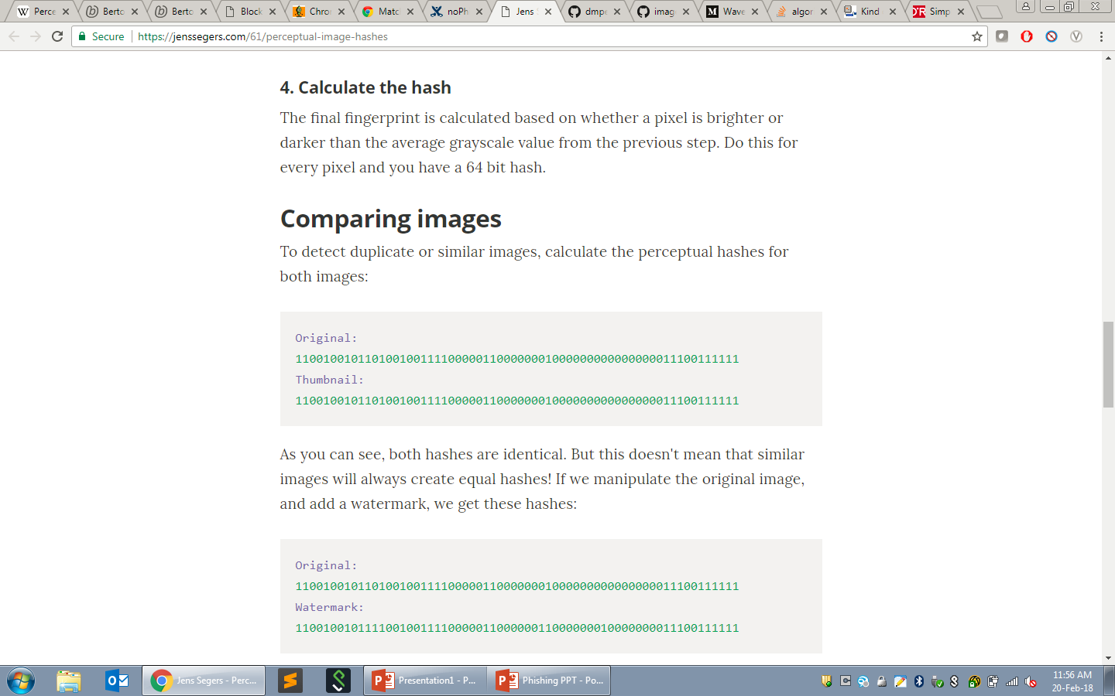
Visual Features
Steps to calculate aHash
Reduce size to 8x8 Covert to grayscale Calculate the average color Calculate the hash
Calculating 5 Features:
singleHash (aHash of complete image)
4 multipleHash (aHash of 4 equally divided sectors).

Slide 22
Let’s Compare the Images

Slide 23
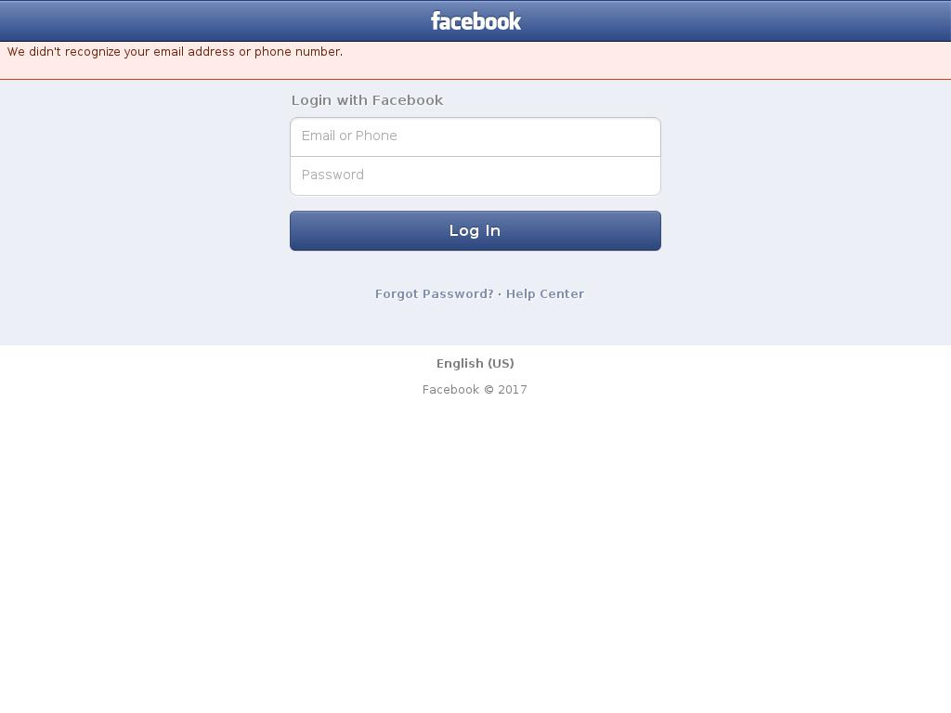
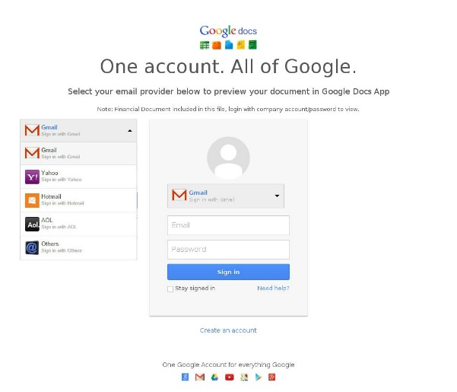
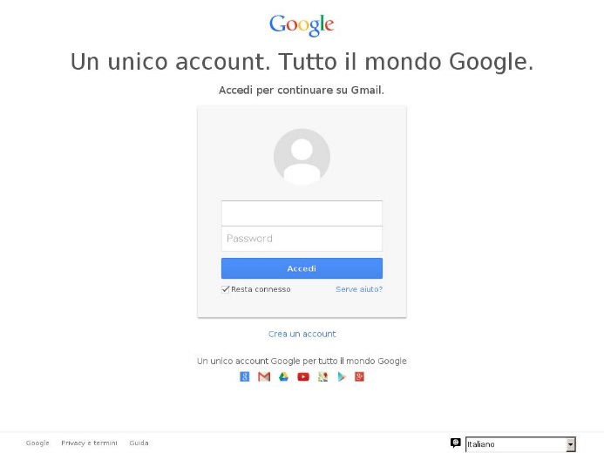
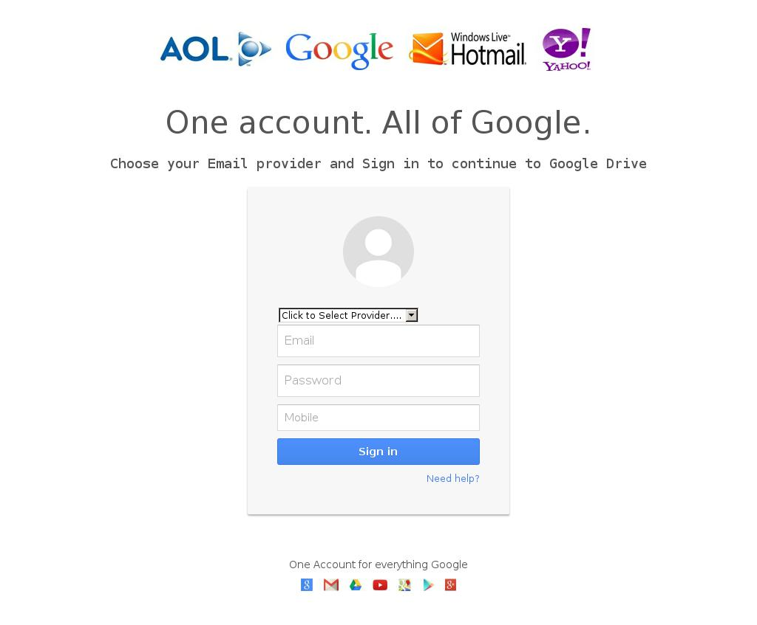
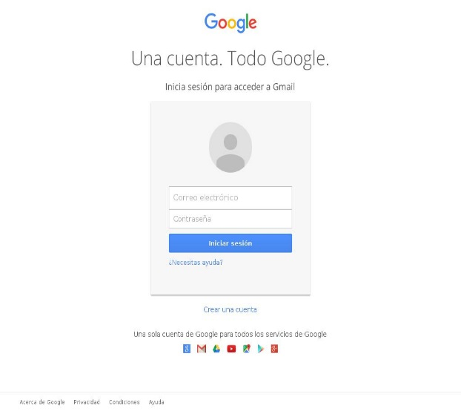
Images used for Benchmarking

Slide 24
aHash:0

Slide 25
aHash:2

Slide 26
aHash:4

Slide 27
aHash:8

Slide 28
aHash:16

Slide 29
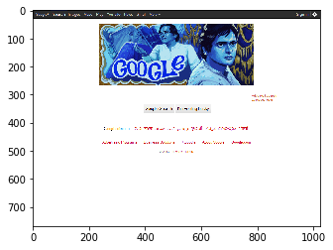
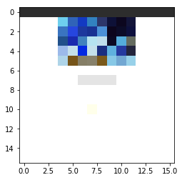
Notes:
4:3 aspect ratio screen included 640 x 480, 800 x 600 and 1024 x 768. If you were really hardcore, you might have 1280 x 1024 and 1600 x 1200 monitor, which called for a more sophisticated video card.
In the early days of LCD panel production, 1024 x 768 panels seemed to be the sweet spot for price to resolution value, representing a good tradeoff between profit and risk of possible manufacturing defects ruining the screen. As a bonus, just about all modern-at-that-time video hardware would support that resolution.
When you expand a 768 pixel tall screen to be a 16:9 widescreen, it becomes 1366 x 768.

Slide 30
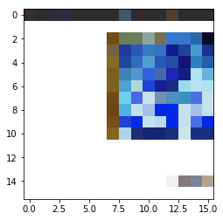
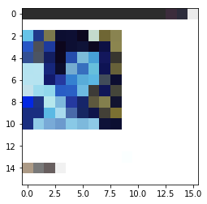
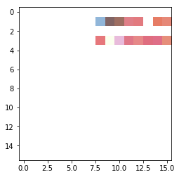
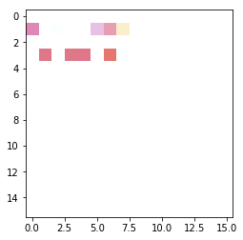

Slide 31
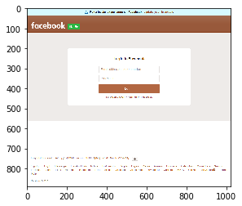
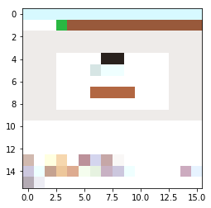

Slide 32
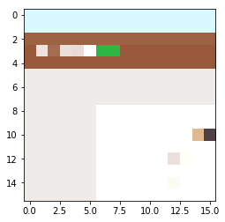
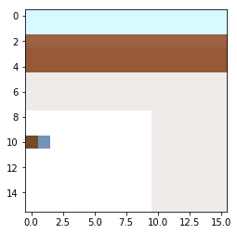
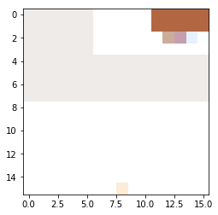
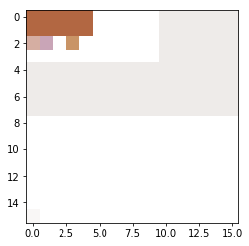

Slide 33
Feature Engineering
Automated Feature Extraction
process of using domain knowledge of the data to create features
increases the predictive power of machine learning algorithms
PhishingOrNot | domainCreationDate | domainExpirationDate | domainLife (in months)
Phishing | 2017-02-20 | 2017-05-20 | 3
Not Phishing | 2015-04-23 | 2018-04-23 | 36
Not Phishing | 2013-02-11 | 2015-09-11 | 24

Slide 34
Problems Faced While Implementation
Automated Feature Extraction
Infinite Time Problem: Takes infinite time to extract a feature and also doesn’t raise any error.
Data Corruption:
Some websites produce following errors which corrupts the data:
403 Error: Error. (For example, Apple)
404 Error: Website Not Found
As phishing sites are short-lived so the content for which it was categorized as Phishing has been replaced by some genuine content.
Account Suspended of the website domain
When the URL link received is not available anymore, usually happens with shortened URL.
When the website is “Sleeping”, usually happens with the websites hosted on some hosting service websites.
The website blocked by Symantec Network.
Note: The above problems occured despite of filter put in the code which makes sure that they are “Valid” and “Online”.

Slide 35
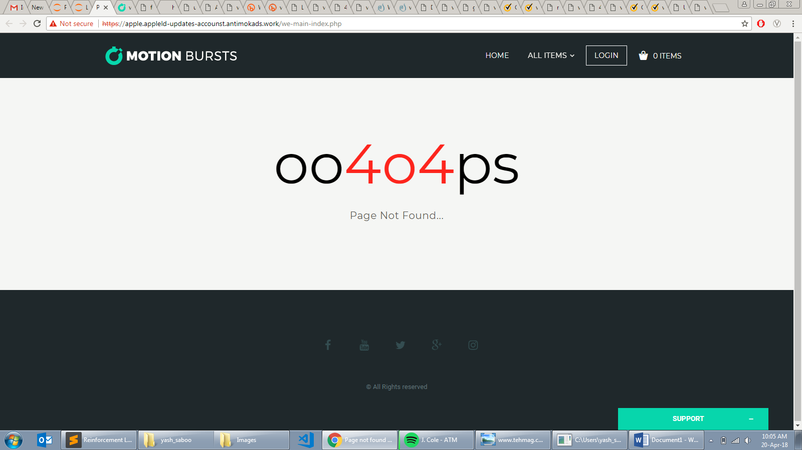
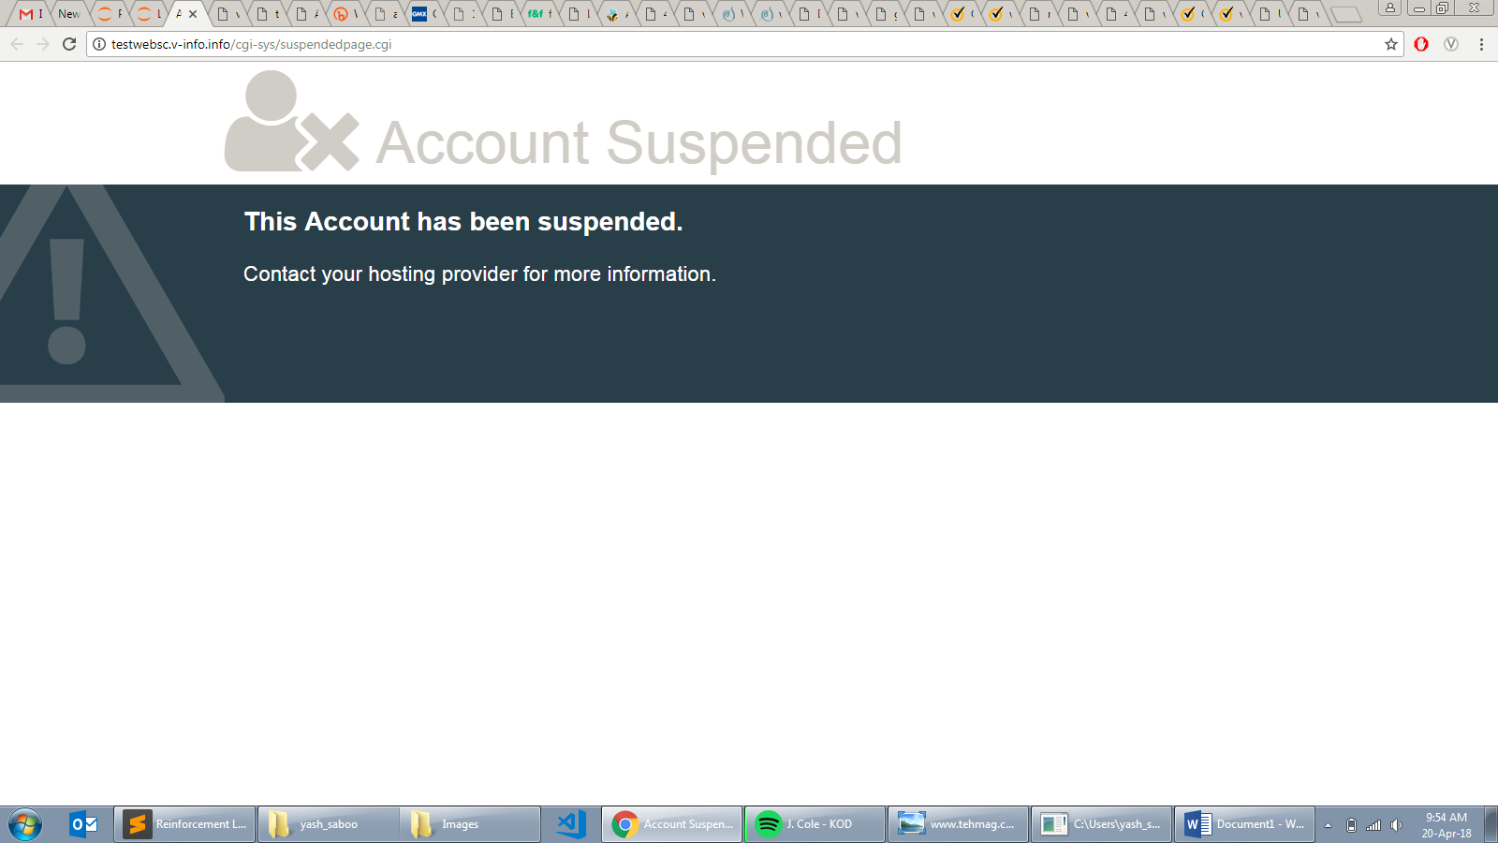
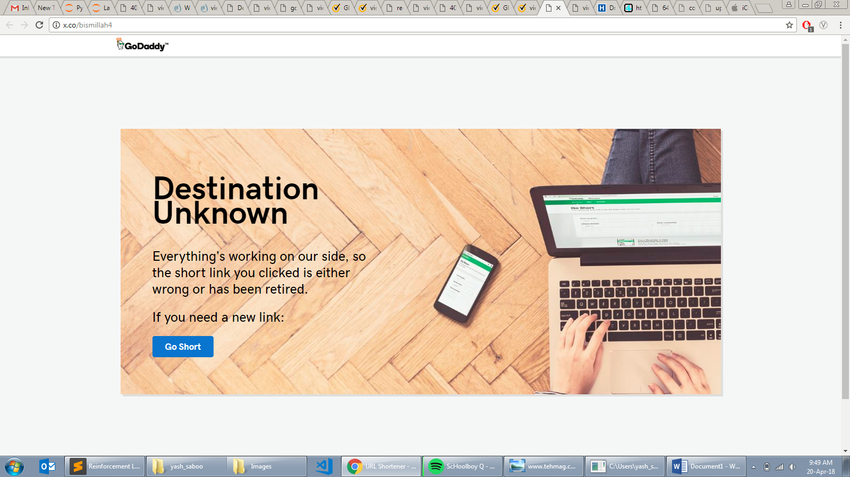
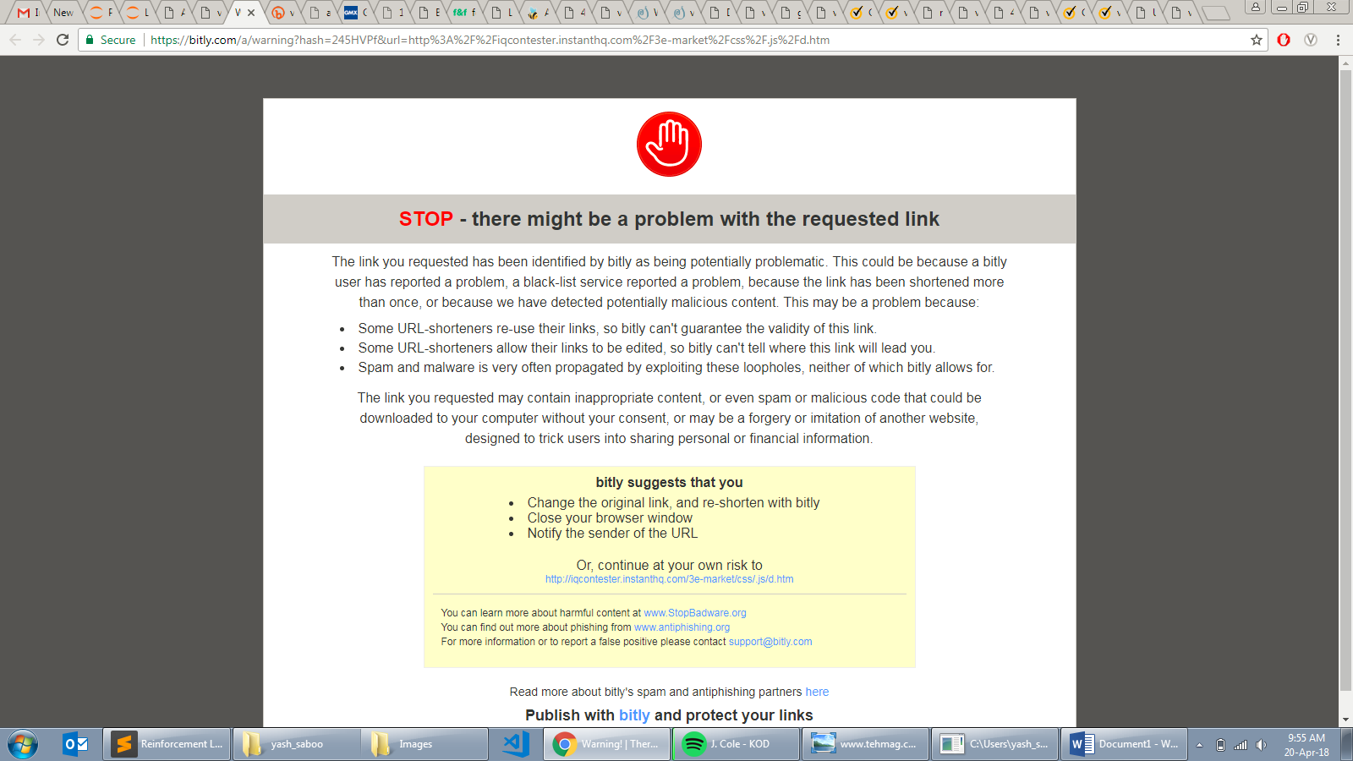
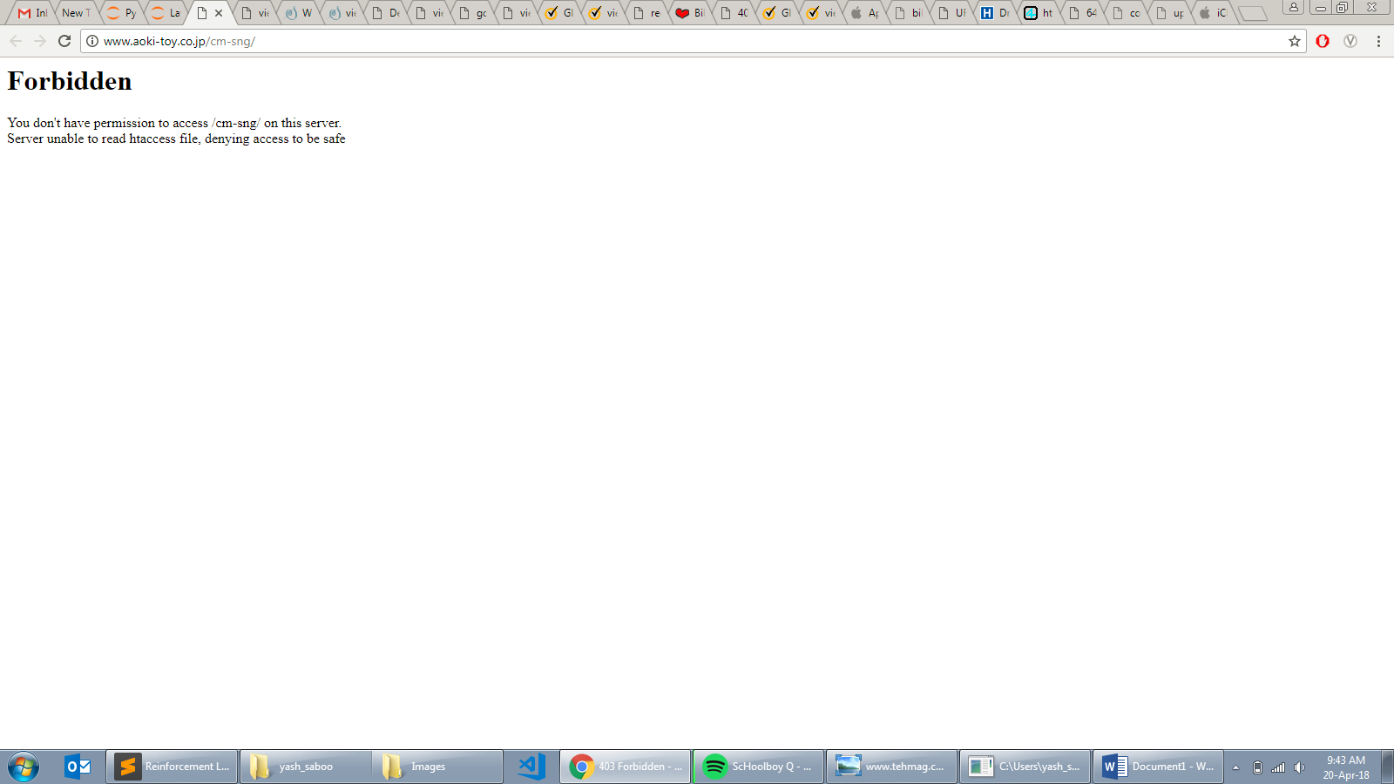
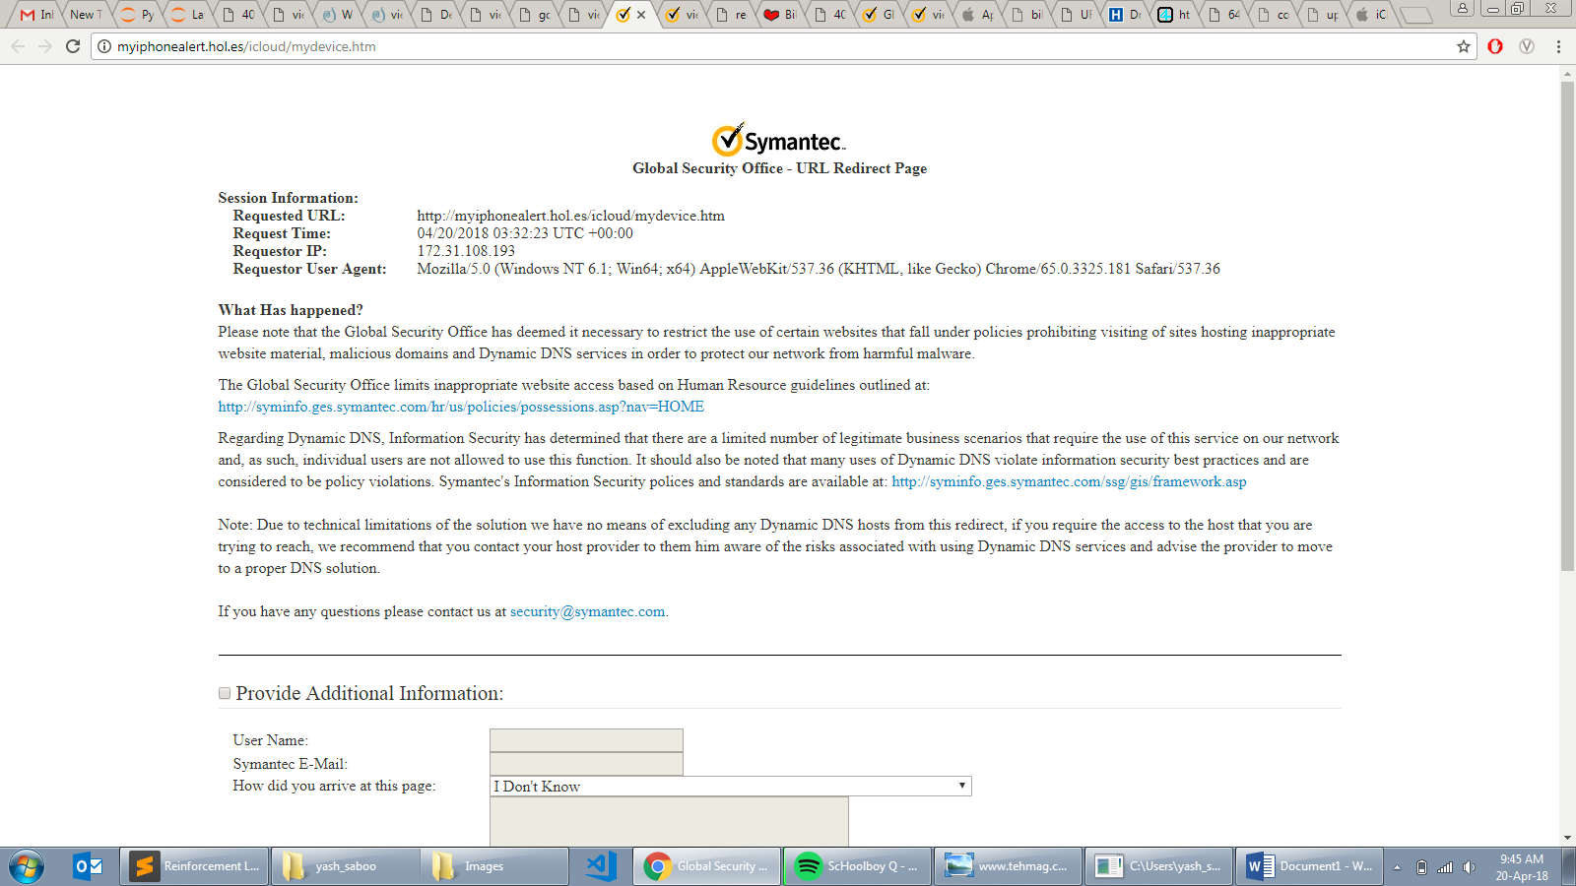
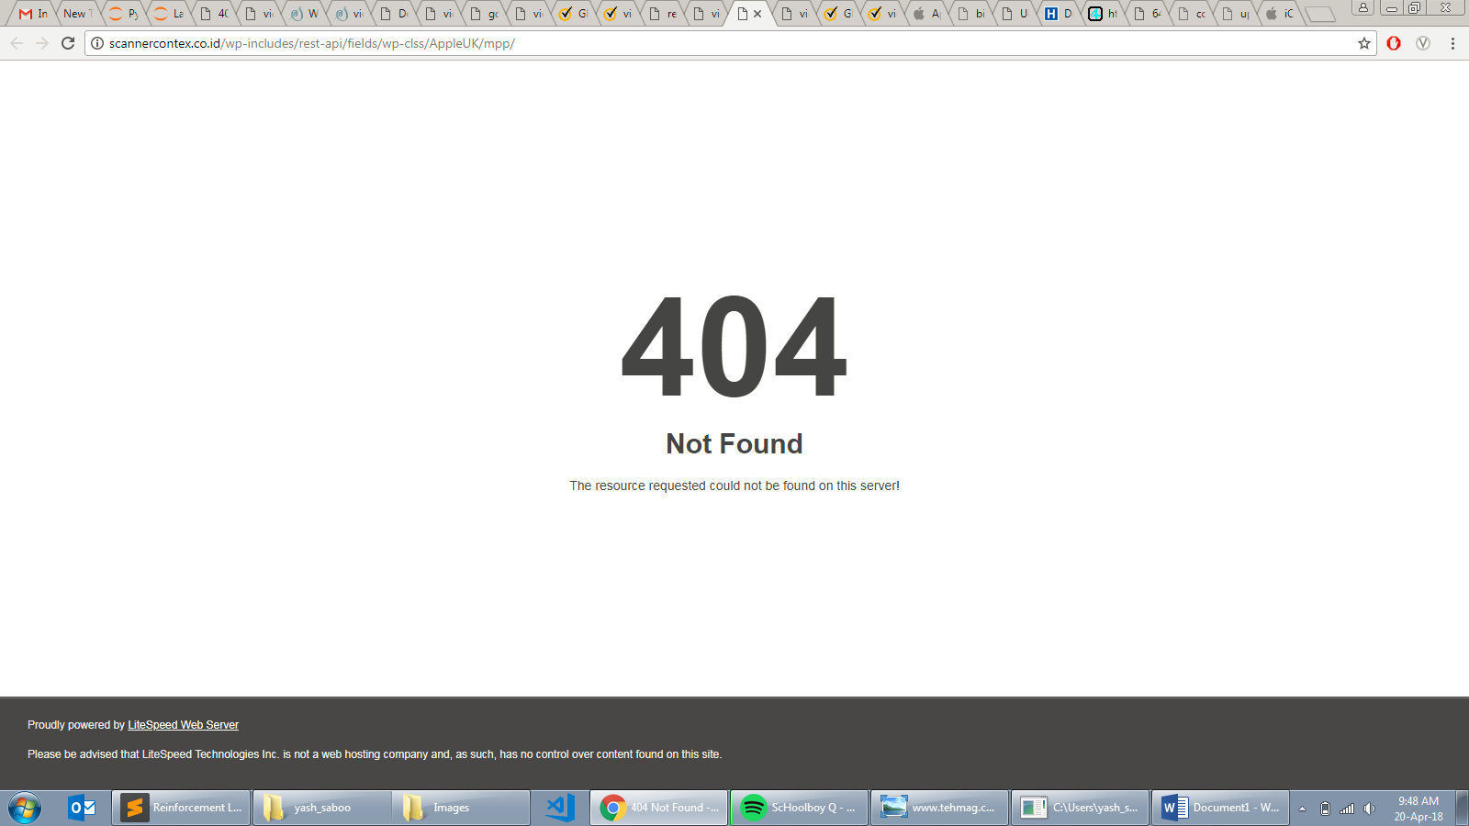
Set of images which leads to Data corruption

Slide 36
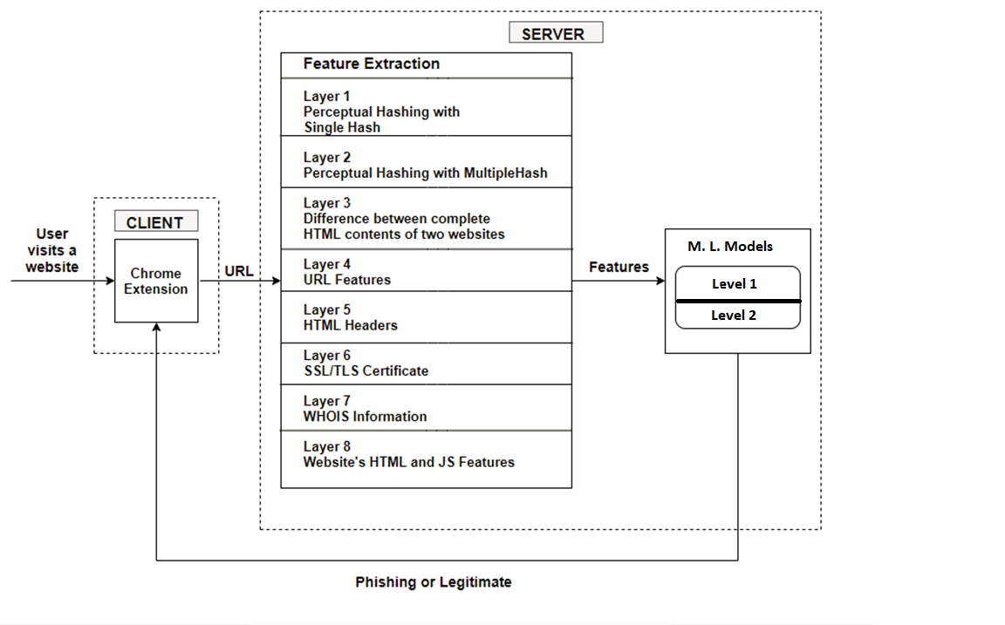
System Architecture

Slide 37
Stage 4
Level 1 Model
A machine learning model was designed to classify websites into Phishing and Legitimate, using Technical Features
Models: Decisions Trees, Random Forests, XGBoost
Learning: Supervised
Data: Unbalanced
Metrics: Accuracy, Receiver Operating Characteristic(ROC) Curve, Feature Importance Map

Slide 38

Decision Tree
Level 1 Model
Type of Learning: supervised
Type of problems it solves: classification
Function: the sample is split into homogeneous sets based on most significant splitter / differentiator in input variables
Problems: over-fitting, solved by random forest

Slide 39
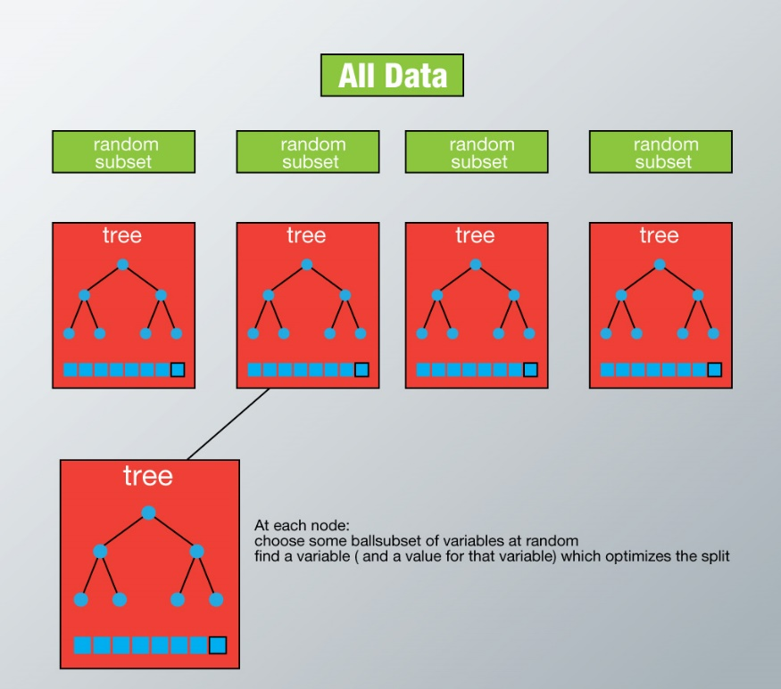
Random Forest and XGBoost
Level 1 Model
Type of Learning: supervised
Type of problems it solves: classification
Function: algorithm creates the forest with a set of decision trees
Power: can handle thousands of input variables and identify most significant variables
XGBoost implements Boosting technique on Random Forest.

Slide 40
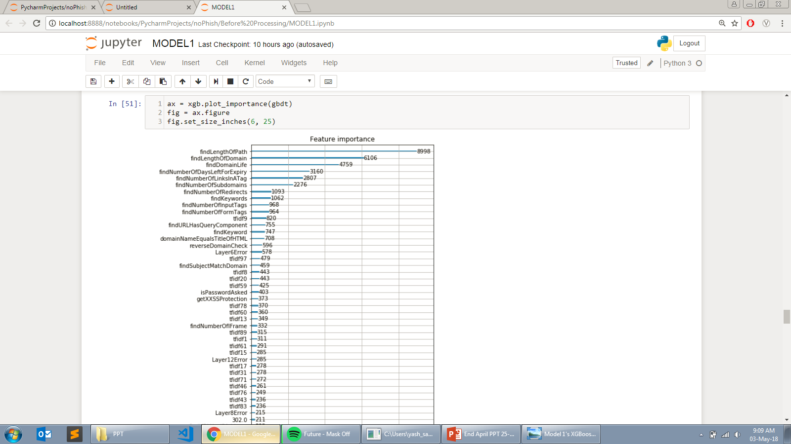
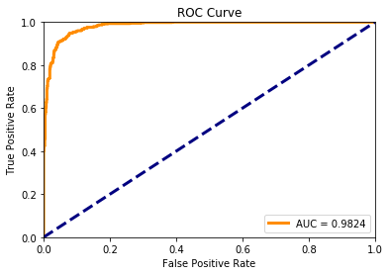
Training and Testing Statistics
Level 1 Model
Total Websites: 5,125
Test Accuracy: 92.52%
Split Ratio: 0.7
Training Websites: 3587
Testing Websites: 1538

Slide 41
Stage 5
Level 2 Model
A machine learning model was designed to classify websites into Phishing and Legitimate, using Visual Features
Models: DBSCAN (Clustering technique)
Learning: Semi-supervised
Data: Unbalanced
Metrics: Confusion Matrix

Slide 42
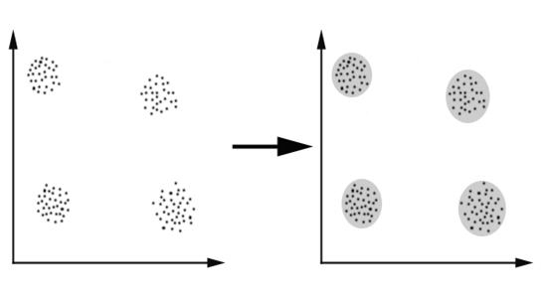

DBSCAN
Level 2 Model
Stands for Density-based spatial clustering of applications with noise.
Type of Algorithm: density-based clustering algorithm
Type of Learning: semisupervised
Method:
For a given set of points in some space,
it groups together points that are closely packed together (points with many nearby neighbors),
and marking as outliers points that lie alone in low-density regions (whose nearest neighbors are too far away).

Slide 43
Terms used in Benchmarking terms
Level 2 Model
TP: A true positive test result is one that detects phishing when the phishing is present.
TN: A true negative test result is one that does not detect phishing when phishing is absent.
FP: A false positive test result is one that detects phishing when phishing is absent.
FN: A false negative test result is one that does not detect phishing when phishing is present.
 | Phishing is present | Phishing is absent
Detects Phishing | True Positive (TP) | False Positive (FP)
Doesn’t Detect Phishing | False Negative (FN) | True Negative (TN)

Slide 44

Training and Testing Statistics
Level 2 Model
Training:
Number of Images: 1358
Number of Training Images: 909
Number of Testing Images: 449
Testing:
True Positive Rate: 81.07%
False Positive Rate: 0.00 %
 | Phishing is present | Phishing is absent
Detects Phishing | 364 | 0
Doesn’t Detect Phishing | 85 | 61
t-SNE dimensionality reduced visualization of the clusters formed by DBSCAN on the training images. The number represented in label denotes the cluster number and each cluster is represented with a color in rainbow scale.

Slide 45
Novelty
Security community is worked a lot in the anti-phishing domain, but ’noPhish’ remains a novel approach in itself
The novelty of noPhish can be viewed with respect to two aspects:
Novel research work
Novel application for Symantec

Slide 46
Novel Research Work
There was considerable amount of novelty in anti-phishing research
noPhish is novel as a whole but has taken inspiration from various research work done individually on technical and visual aspects.
Research Title (Authors) | Inspiration
AJNA (Pernelle Mensah et al.) | SSL/TLS certificate
Detection of Phishing URLs Using Machine Learning Techniques (Joby James et al.) | WHOIS
PhishAri (Anupama Aggarwal et al.), Large-Scale Automatic Classification of Phishing Pages (Colin Whittaker et al.) , Phishing Websites Features (Rami M. Mohammad et al.), Detection of Phishing Emails using Feed Forward Neural Network ( Noor Ghazi M. Jameel et al.) | URL, HTML and JavaScript
Know Your Phish (Samuel Marchal et al.) | Web Scraping
Inspiration taken from various research work for technical features

Slide 47
Novel Research Work
There was considerable amount of novelty in anti-phishing research
The algorithm chosen for visual features, aHash, was different from the algorithm chosen by other research work. The other research works has chosen difference Hash and pre-existing image libraries such as ImageNet.
Also, we used an enhanced version of aHash which is not yet available to public.
The Level 2 of noPhish - semi-supervised DBSCAN clustering - is a unique approach and, to my best knowledge, has not been yet implemented by anyone yet.

Slide 48
Novel Product
Usefulness to Symantec
noPhish is unique because it uses both visual and technical features to identify phishing websites in ‘real-time’.
There have been attempts, but no product known as harnessed such features using machine learning and data mining approach.
Also, in Symantec, no such technique is used in their anti-phishing product.
Thus, techniques used in noPhish will be incorporated in anti-phishing product and collaborated with Norton browser extension in future.

Slide 49
Software Tools
The following software tools were used while developing noPhish:
Operating System | Windows 7, Ubuntu Linux 16.0 (For Stage 3)
Web Server | Flask, Wamp
Web Technologies | JavaScript, HTML, CSS
Programming Language | PHP, Python
Web Service | REST
Text Editor | Sublime Text 2, Visual Studio Code, Jupyter Notebook
Version Control | Git
Collaboration | Atlassian Stash

Slide 50
Hardware Tools and Process Model
There is no specific hardware required but the following hardware tools were used along with a specific process model:
Processor | Intel Core i7-6700HQ
Frequency | 2.60 GHz
Cores | 4
RAM | 8 GB
Class | DDR3
Storage | 2 TB
Process Model | Agile Scrum

Slide 51

Data Flow Diagram
Level 2

Slide 52
Functional decomposition and Work Breakdown Structure
Process of taking a complex process and breaking it down into its smaller, simpler parts
noPhish
Planning
Literature Survey
Finding Anti-Phishing Techniques
Stage 2 (Code Comparator)
Design Proof of Concept
Implement Client-Server Architecture
Stage 1 (Chrome Extension)
Design and Modular Execution
Implementation and Design
Stage 4 (Level 1 - XGBoost)
Train the Model
Hyperprarameter Tuning
Stage 3 (Automated Feature Extraction)
Extract Technical and Visual Features
Filter Error-Prone Websites
Stage 5 (Level 2 - DBSCAN)
Train the Model
Hypterparameter Tuning
Documentation
Requirement Analysis
Establish Project Goals
Code Check-In and Write Wiki Pages
No. | Task | Days | Start Date | Finish Date
 | Planning | 23 | 10-01-2018 | 02-02-2018
1. | Literature Survey | 08 | 10-01-2018 | 18-01-2018
2. | Find Anti-Phishing Techniques | 11 | 18-01-2018 | 29-01-2018
3. | Establish the Project Goals | 02 | 29-01-2018 | 31-01-2018
4. | Requirement Analysis | 02 | 31-01-2018 | 02-02-2018
 | Implementation and Coding | 130 | 02-02-2018 | 12-06-2018
5. | Stage 1 (Chrome Extension) | 34 | 02-02-2018 | 08-03-2018
6. | Stage 2 (Code Comparator) | 16 | 08-03-2018 | 24-03-2018
7. | Stage 3 (Automated Feature Extractor) | 32 | 24-03-2018 | 25-04-2018
8. | Stage 4 (Level 1 – XGBoost) | 26 | 25-04-2018 | 21-05-2018
9. | Stage 5 (Level 2 – DBSCAN) | 22 | 21-05-2018 | 12-06-2018
 | Documentation | 06 | 12-06-2018 | 18-06-2018
10. | Code Check-In and Write Wiki Pages | 04 | 12-06-2018 | 16-06-2018

Slide 53

Gantt Chart
Bar chart that illustrates a project schedule

Slide 54
Conclusion
noPhish – an effective method to classify websites into Phishing and Legitimate (Non-Phishing) using Machine Learning, Image Processing, and Data Mining techniques – was successfully built.
The methodology exploits not only the technical features of the website based on URL specifics, WHOIS, HTML Headers, SSL/TLS certificate and page source (underlying code) of the website, but also the visual features of the website in real-time.
Done with the integration of Machine Learning techniques.
As a proof of concept, a Chrome browser extension was built.
It was also established that comparing page source (underlying code of the website) of websites doesn’t help in predicting if a website is phishing or not.
It is to the best knowledge, that noPhish is the first way to classify website on both the technical and visual aspect of the website in real-time.

Slide 55
Future Work
Over the period of this project, a great many improvements and ideas were established that can be investigated in the future.
Most pages have advertisements on them, i.e. dynamic elements which keep changing and hence, lead to new image hashes being generated every time for the same page. Add a functionality to blank out advertisements from the page before screenshot.
Ignoring the noise on the webpage and image hashing only the important content can be done. Noise reduction is done by a Chrome Extension called Mercury and its source code can be useful.
Enable permanent whitelisting of trusted domains that show up as false positives. If a user clicks allow, never show an alert on that website.
Show the user the precise URL which is being phished.
Create a database of popular brands’ URL and their respective favicon. If any other website uses the same favicon, regard that as phishing. Derive a proof of concept and add it as Level 3 of noPhish.
More effective machine learning algorithms for training the predictive models.
More effective feature extraction and representation learning (e.g., via deep learning approaches).

Slide 56
Bibliography
https://www.pinterest.com.au/pin/61220876165007473/visual-search/?x=0&y=0&w=564&h=687
https://www.wired.com/2017/03/phishing-scams-fool-even-tech-nerds-heres-avoid/
http://www.foxnews.com/tech/2017/03/16/warning-dangerous-new-gmail-phishing-attack-can-easily-steal-your-google-login.html
https://www.csoonline.com/article/2132618/phishing/11-tips-to-prevent-phishing.html?upd=1516601104944
https://www.csoonline.com/article/2117843/phishing/what-is-phishing-how-this-cyber-attack-works-and-how-to-prevent-it.html?nsdr=true
https://community.mimecast.com/docs/DOC-1027
https://community.mimecast.com/docs/DOC-1995
https://www.mimecast.com/blog/2015/08/under-the-hood-our-new-email-attachment-sandbox/
https://www.sandboxie.com/EmailProtection
https://techterms.com/definition/sandboxing
https://www.fortinet.com/content/dam/fortinet/assets/solution-guides/Why-Do-You-Need-Sandboxing
http://www.kansas.com/news/local/crime/article88960532.html
https://techcrunch.com/2016/03/15/prosecutors-find-that-fappening-celebrity-nudes-leak-was-not-apples-fault/
https://www.cbsnews.com/news/the-phishing-email-that-hacked-the-account-of-john-podesta/

Slide 57
Thank You
Yash Saboo
yashsabooo99@gmail.com

